Slide 2
Gender and Leadership in Higher Education in Nigeria
Organised by
Kaduna State University, Nigeria
In partnership with
York St John University, United Kingdom

Slide 3
Welcome to the training on Grant writing, publishing, collaboration and visibility
Date: 12th December 2024
Time: 08:30 AM
Venue: Postgraduate School Board Room, Kaduna State University

Slide 4
Schedule of the day
Schedule | Activity
08:30 - 09:00 | Registration Tea/Coffee
09:00 - 09:15 | Welcome/Introduction/Housekeeping
09:15 - 11:00 | Session 1: Grant writing and research funding
11:00 - 11:30 | Break
11:30 – 13:00 | Session 2: Academic writing and publishing
13:00 - 14:00 | Lunch Break/Networking
14:00 – 15.00 | Session 3: Collaboration and building partnerships
15:00 - 15:30 | Break
15:30 – 16:30 | Session 4: Visibility and building network
16:30 - 16:45 | Closing remarks and presentation of certificates

Slide 5
House Keeping/Introductions

Slide 6
Session 1: Grant writing

Slide 7
Grant Writing and Research Funding
Dr. Olalekan Adekola
12 December 2024
Notes:
m,

Slide 8
About me!
I am a Geographer/Environmental Scientist. Most of my research focuses on Sustainability-related topics.
Outside of study scholarships, my first big grant application was in 2015 (so I'm also a newbie ☺).
Most of my grant applications are in the UK, but also have some experience of the application landscape in ‘Europe’, Canada, South Africa and Nigeria.
I have a track record of regularly reviewing grant applications for funding bodies. I have reviewed applications for UKRI (NERC and ESRC) and Leverhulme Trust and I am on the NERC Peer Review College.
Notes:
UK and Geography or Environmental Sceince centric

Slide 9
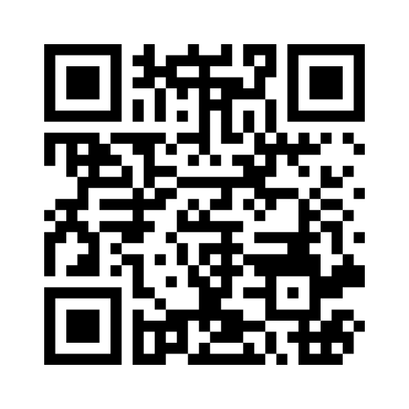
Let's Begin
Go to www.menti.com
Use the code [7258 3292]
Answer the questions

Slide 10
Key Focus Areas
Understanding the funding landscape
Identifying funding opportunities
Understanding the grant application process
Aligning your proposal with funders' priorities
Writing clear and compelling narratives
Notes:
Some of the discussions can be UK centric

Slide 11
Learning Outcomes
By the end of the session, you will:
Identify appropriate funding source
Know how to structure a successful grant proposal
Gain insights into what funders look for
Learn strategies to strengthen your application

Slide 12
Overview of Key Research Funding Sources
Government Funding Bodies: National (UKRI, Tetfund) or International (Horizon Europe); National Science Foundation (NSF - USA); National Research Foundation (NRF-SA).
Charitable Foundations and Trusts: The Welcome Trust, Leverhulme Trust, Bill & Melinda Gates Foundation, Nuffield Foundation
Corporate and Industry Partnerships: Innovate UK
Professional and Academic Associations: Royal Society, British Academy, Royal Academy of Engineering, The Academy of Medical Sciences.
Regional and Development-Focused Sources: Global Challenges Research Fund (GCRF); Newton Fund; British Council
Specific-Theme Funding: Belmont Forum, Green Climate Fund, National Institute for Health Research (NIHR)
Crowdfunding and Community-Driven Sources: Experiment.com or FundRazr

Slide 13
Types of Research Funding
Research Grants (for research projects, covers salaries, equipment, consumables, and dissemination e.g. UKRI)
Fellowships (for individual career development, cover salary support, training, and independent research e.g. Leverhulme Trust Fellowship).
Travel Grants (for travel to conferences, workshops etc)
Seed Funding (for early-stage or pilot research projects)
Collaborative and Industry Funding (for partnerships between academia and industry e.g. Innovate UK Collaboration Grants, UK).
Postdoctoral and Early Career Funding (for early-stage researchers to establish independent careers)
Capacity Building and Training Grants (enhance research capacity in specific regions or disciplines e.g. Global Challenges Research Fund, GCRF, UK)
Conference and Dissemination Grants (Fund dissemination of research findings or organization of academic events)

Slide 14
Finding Relevant Funding Calls
Use online funding databases and portals (Research Professional, CORDIS (EU), Pivot-RP, Grants.gov (USA), UKRI (UK)
Subscribe to funding alerts (email alerts or follow funding agencies on social media)
Network with peers and collaborators (e.g. research groups, conferences, listserve etc.)
Attend information sessions and webinars (many funding bodies host regular info sessions)
Engage professional associations and networks (RGS-IBG and collaborate with colleagues who may already be familiar with relevant funders)
You must be clear about your research objectives, scope, scale, and timeline of your project.

Slide 15
Review the document on key grant awarding bodies.

Slide 16
Now you think you have found the right call for you …. before you start writing and forming a team …

Slide 17
Interpreting Guidelines and Eligibility Criteria
Read the guidelines thoroughly (have a good grasp of the funder’s objectives and the focus of the call)
Check eligibility requirements (focus on both applicant and project eligibility)
Check budget restrictions (funding amount and eligible costs)
Understand submission requirements (deadlines, format, submission process)
Pay attention to review criteria
Clarify terms and conditions (funding period and reporting requirements)
Tips: If in doubt, contact the funders to seek clarification, compare to past calls or awarded projects, or seek expert advice.

Slide 18
Structuring a Winning Proposal
Key elements/sections to expect in a grant application:
Abstract, executive or lay summary
Project description
Objectives
Work plan
ODA Justification statement
Equitable partnerships statement
Dissemination, Outreach and Publications
Ethics
Risk management

Slide 19
Crafting A Clear Grant Proposal

Slide 20
Align Objectives with the Funder’s Goals
Understand the Call: Carefully review the grant’s purpose and priorities.
Match Priorities: Ensure your objectives align with the funder’s thematic or strategic focus.
Example: If the grant focuses on sustainability, emphasize measurable outcomes related to environmental or social impact.

Slide 21
Use the SMART Framework
Specific: Clearly define what you intend to achieve.
Example: Develop a model for predicting coastal flooding in Nigeria under future climate scenarios.
Measurable: Include quantifiable metrics to track success.
Example: Increase crop yield by 15% through improved irrigation techniques within three years.
Achievable: Ensure objectives are realistic given your resources and timeline.
Relevant: Relate to your research question and the funder’s priorities.
Time-bound: Specify a clear timeframe for each objective.

Slide 22
Break Down Objectives into Manageable Steps
Divide overarching goals into smaller, achievable tasks.
Example:
Objective 1: Conduct a systematic literature review on urban climate adaptation.
Objective 2: Develop a GIS-based vulnerability assessment model.

Slide 23
Focus on Outcomes and Impact
Highlight the broader significance of achieving your objectives (e.g., societal, environmental, or economic benefits).
Example: Contribute to disaster risk reduction policies in coastal regions by providing evidence-based strategies for flood management.

Slide 24
Use Clear and Concise Language
Avoid jargon. Write for reviewers who may not be experts in your field.
Keep objectives short, straightforward, and focused.

Slide 25
Demonstrate Innovation and Originality
Showcase how your objectives address gaps in current knowledge or practice.
Example: Introduce a novel framework for community-led adaptation strategies in rural Africa.

Slide 26
Connect Objectives to Deliverables
Link each objective to tangible outputs, such as publications, tools, or policy briefs.
Example: Objective: Develop an open-access database of regional biodiversity.
Deliverable: Publish and maintain the database online for public access."

Slide 27
Writing a Compelling Narrative

Slide 28
Structure the Narrative Logically
Problem Statement: Define the issue your project addresses.
Objectives: Clearly state what you aim to achieve.
Methodology: Provide a concise overview of how you will achieve your goals.
Impact and Alignment: Emphasize the outcomes and their relevance to the funder’s goals.

Slide 29
Start with a Strong Introduction
Capture Attention: Begin with a compelling statement that highlights the significance of your research problem.
Clearly State Alignment: Explicitly connect your project to the funder’s priorities in the opening paragraph.
Example: This project addresses the urgent need for equitable access to climate-resilient infrastructure, aligning with the funder’s commitment to sustainable development.”

Slide 30
Highlight the Significance of Your Research
Define the Problem: Explain the societal, scientific, or economic challenge your research addresses.
Show Urgency: Use data and real-world examples to underscore the importance of solving this problem now.
Example: Rising sea levels threaten 200 million people globally. This project provides actionable solutions for communities most at risk.

Slide 31
Showcase Innovation and Impact
Innovative Approach: Explain how your project is novel or fills a gap in existing knowledge or practice.
Clear Impact Pathways: Describe the specific outcomes and benefits of your research, focusing on the funder’s priorities.
Example: “Our work will result in a low-cost, scalable system for water purification in underserved areas, directly addressing the funder’s commitment to global health equity.”

Slide 32
Demonstrate Feasibility and Expertise
Highlight your team’s qualifications, experience, and past successes to build credibility.
Include a brief timeline and milestones to show your plan is achievable within the grant’s scope.

Slide 33
Address Equity, Diversity, and Inclusion (EDI)
If applicable, showcase how your project incorporates EDI principles, particularly if the funder prioritizes these values.
Example: “This project will train early-career researchers from underrepresented groups in cutting-edge climate modeling techniques.”

Slide 34
Use Data and Evidence Strategically
Support your claims with relevant statistics, case studies, or research findings.
Avoid overwhelming the narrative with excessive detail—prioritize key data that reinforces your story.

Slide 35
End with a Strong Conclusion
Reiterate the significance of your project and its alignment with the funder’s goals.
End with a compelling call to action that highlights why your project deserves funding.
Example: “This project offers a transformative opportunity to advance sustainable agriculture in Africa, directly addressing the funder’s vision of food security for all.”

Slide 36
There are two grant applications made available for you to review. Take some time to look at the key elements.
What are the strengths and weaknesses of each?
How will you improve either of these?
Which one do you think got funded? NB: Both applications are over 5 years old

Slide 37
Budgeting and Financial Planning
Develop a realistic and detailed budget.
Justify expenses (personnel, equipment, travel, indirect costs).
Remember to ensure financial compliance and accountability for grant management.

Slide 38
Building Collaborative Partnerships
Networking and collaboration as tools for securing larger grants.
Managing multi-institutional proposals and shared funding.
Leverage networks and opportunities
Identify complementary strengths
Build trust and open communication
Focus on shared goals
Develop a formal agreement
Be Inclusive and diverse (stakeholders, sectors, gender etc)
Share resources and benefits equitably

Slide 39
Common Pitfalls in Grant Writing
Lack of Clarity in Objectives
Not Aligning with the Funder’s Priorities
Weak Problem Statement
Overlooking Guidelines and Eligibility Criteria
Poorly Defined Budget
Lack of Focus in the Narrative
Inadequate Demonstration of Feasibility
Weak Description of Impact
Failing to Address Sustainability
Insufficient Collaboration or Stakeholder Engagement
Using Jargon or Unclear Language
Neglecting to Proofread and Edit
Missing Deadlines
Weak or Missing Supporting Documents
Overlooking or not seeking Feedback

Slide 40
Q&A

Slide 41
Key Takeaways
Take your time to identify appropriate grants
Be organized and start early
Understand the funder’s priorities
Write clear and realistic objectives
Craft a compelling narrative
Demonstrate feasibility
Follow guidelines precisely
Focus on impact
Seek feedback and support

Slide 42
You can read: Understanding and fixing common paragraph problems, by Ruth Oji

Slide 43
Thank you
Email: o.adekola@yorksj.ac.uk Twitter: @drlekad

Slide 44
Session 2: Academic writing and publishing

Slide 45
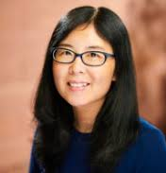
Prof. Ming Cheng
Ming Cheng is a Professor of Higher Education at the Sheffield Institute of Education. She has over 15 years’ international experience of teaching and research in British and Chinese universities. Ming is interested in exploring ways of improving the quality of university education, enhancing academics’ professionalism, and improving students’ learning experiences. Her work has been published in Higher Education, Studies in Higher Education, Quality in Higher Education, Higher Education Research and Development, Teaching in Higher Education and the Journal of Further and Higher Education. Her research has featured in the University World News and the Economist Group. Ming has a track record of winning research grants from external funding bodies such as Quality Assurance Agency (QAA), Higher Education Academy (HEA), QA-QE SIG funding, Society for Research into Higher Education (SRHE), British Association for International and Comparative Education (BAICE), and Arts and Humanities Research Council (AHRC). She recently received the 2020 Innovative Research in International Education Award issued by NAFSA’s Teaching, Learning, and Scholarship Knowledge Community (TLS KC).

Slide 46
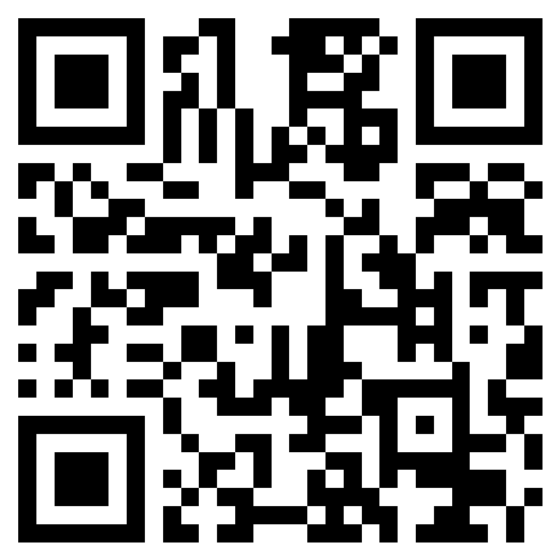
Thank you for attending the training! We would greatly appreciate it if you could take a moment to complete the evaluation form.
https://forms.office.com/e/J805JcZTb4
Follow us on: www.whesh.org

Slide 47
Group Photograph

Slide 48
On behalf of all the partners, Prof. Abdulahi Musa, Vice Chancellor of Kaduna State University, extends his sincere gratitude for your participation in this training.

